Slide 1
Targeted Therapy for Proteus Syndrome: AIM Proteus
Christopher Ours, MD
PSF Family Conference
October 7, 2022

Slide 2
Why Targeted Therapy?

Slide 3
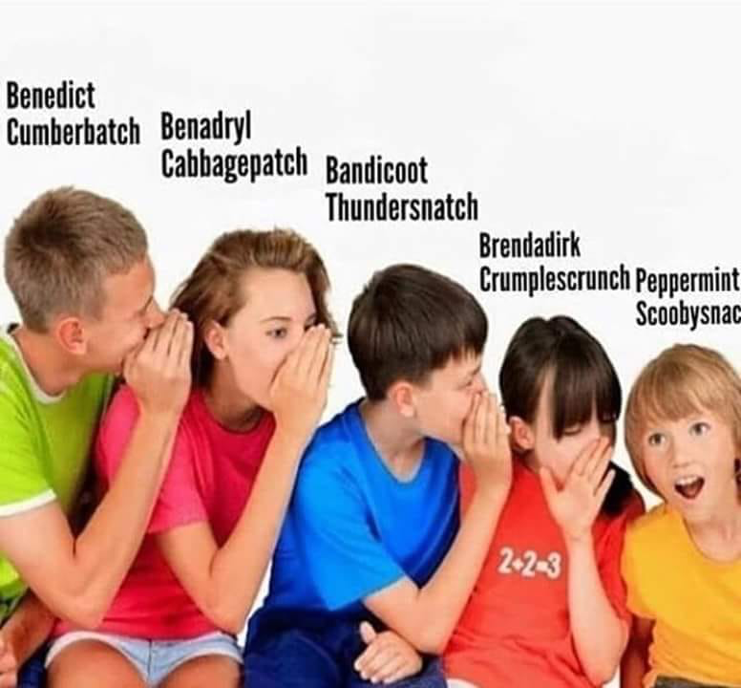
Correct the message
Grow..
Grow..
Grow..
Grow..
Grow..
AKT1
Song et al., Cancer Research, 2019.
Notes:
The PI3K/AKT signaling pathway, including PTEN, PIK3CA, and AKT, is among the most altered cell signally pathways in cancer.
The importance of this pathway in cancer has led to the development of multiple inhibitors including direct AKT inhibitors.
In addition to malignancies, mTOR inhibition with sirolimus has successfully treated vascular anomalies.

Slide 4
Correct the message
Grow..
Grow..
GROW!
GROW..
GROW..
AKT1
E17K
Song et al., Cancer Research, 2019.
Notes:
The PI3K/AKT signaling pathway, including PTEN, PIK3CA, and AKT, is among the most altered cell signally pathways in cancer.
The importance of this pathway in cancer has led to the development of multiple inhibitors including direct AKT inhibitors.
In addition to malignancies, mTOR inhibition with sirolimus has successfully treated vascular anomalies.

Slide 5
Correct the message
Grow..
Grow..
GROW!
GROW..
GROW..
AKT1
E17K
Song et al., Cancer Research, 2019.
Notes:
The PI3K/AKT signaling pathway, including PTEN, PIK3CA, and AKT, is among the most altered cell signally pathways in cancer.
The importance of this pathway in cancer has led to the development of multiple inhibitors including direct AKT inhibitors.
In addition to malignancies, mTOR inhibition with sirolimus has successfully treated vascular anomalies.

Slide 6
Correct the message
Grow..
Grow..
GROW!
Grow..
Grow..
AKT1
E17K
Song et al., Cancer Research, 2019.
Notes:
The PI3K/AKT signaling pathway, including PTEN, PIK3CA, and AKT, is among the most altered cell signally pathways in cancer.
The importance of this pathway in cancer has led to the development of multiple inhibitors including direct AKT inhibitors.
In addition to malignancies, mTOR inhibition with sirolimus has successfully treated vascular anomalies.

Slide 7
So many questions…
What dose?
Is it safe?
What does it mean to say it works?
How do you measure that?
Does it work?
For how long does it work?
How long is treatment needed?
Can it be combined with surgery?
When should treatment start?
Will more than one treatment be needed?

Slide 8
What dose? “Phase 0/1”

Slide 9
What dose? “Phase 0/1”

Slide 10
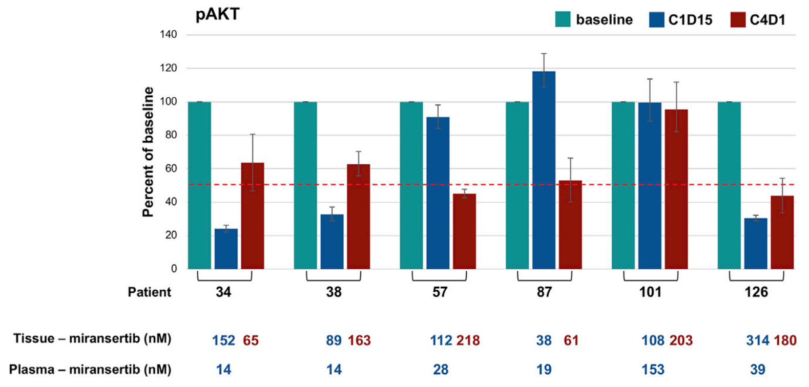
Miransertib 5 mg/m²/day 50% Reduction in p-AKT in Affected Tissue
Keppler-Noreuil et al., American Journal of Human Genetics, 2019.

Slide 11
Is it safe? ”Phase 1”

Slide 12
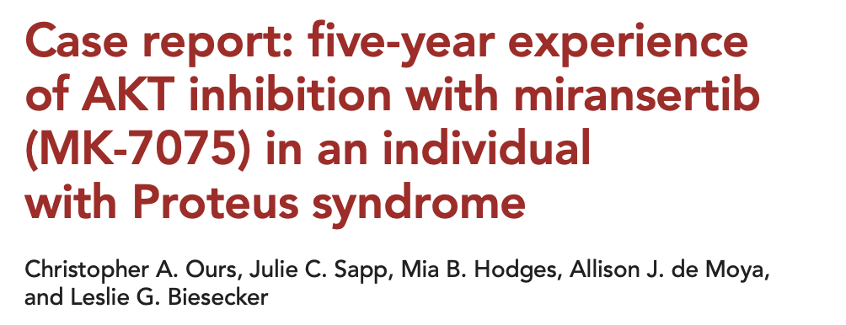
Is it safe? “Phase 1”

Slide 13
Is it safe?

Slide 14
Is it safe?
More common
Tummy troubles (nausea, diarrhea)
Rash
Dry mouth, sores
Headache
Less common
Increase in blood sugar and insulin levels (diabetes-like)
Increase in liver tests
Decrease in blood counts
Most side effects are mild and do not require any additional treatment.
If side effects are severe enough, miransertib is stopped until side effect has improved or resolved.z

Slide 15
What does “working” mean?

Slide 16
What does “working” mean?
Feel
Function
Efficacy
Survive

Slide 17
How do you measure that?

Slide 18
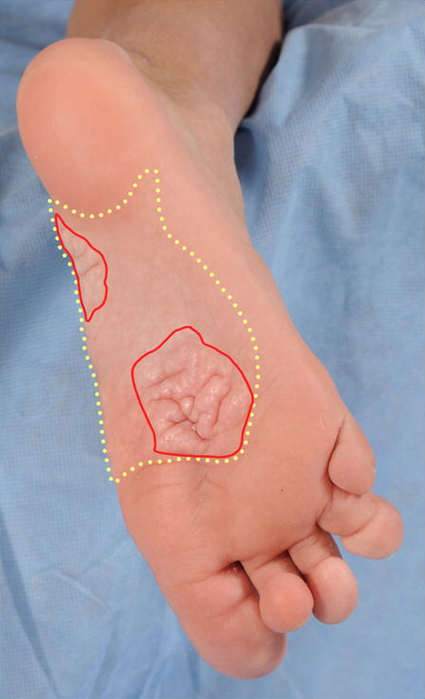
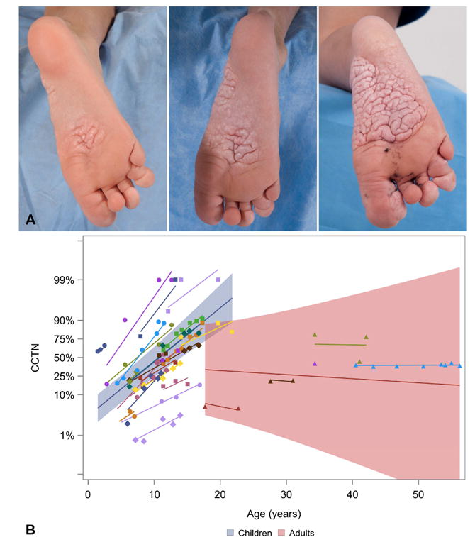
CCTN involves ~5% more of the plantar surface per year during childhood
CCTN
= % CCTN
Plantar surface
Nathan et al., Journal of the American Academy of Dermatology, 2018.

Slide 19
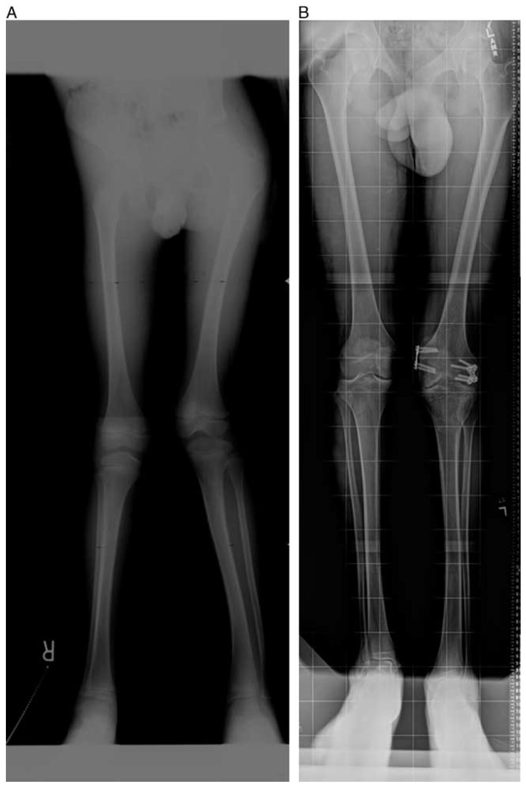
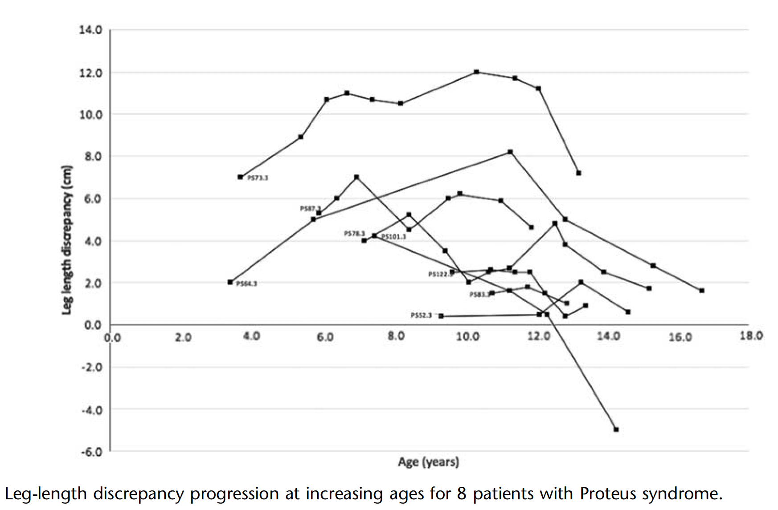
Leg length discrepancy
7 years 15 years
Crenshaw et al., J Child Ortho, 2018.
Notes:
Often the first manifestation noted by parents is disproportional leg growth. By age 3-4 there can be a leg length discrepancy of 2-8 cm.
Conservative treatment with shoe-lifts or other orthotic devices. But epiphysiodesis with 8-plates can help the correction.

Slide 20
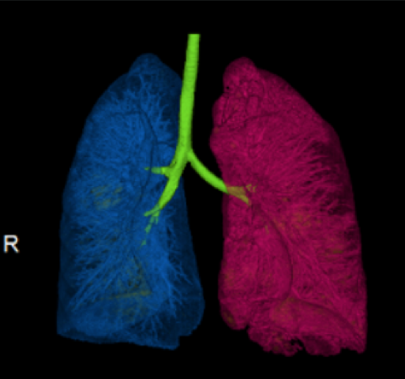
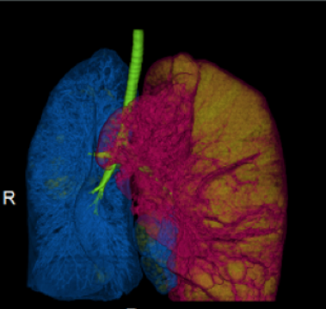
Measurement with Low Dose CT Improves Quantitation of Cystic Lung Disease
5-year-old
10-year-old
= lung bullae ($\text{≤}$ -900 HU)
2.6% diseased tissue
21.5% diseased tissue

Slide 21
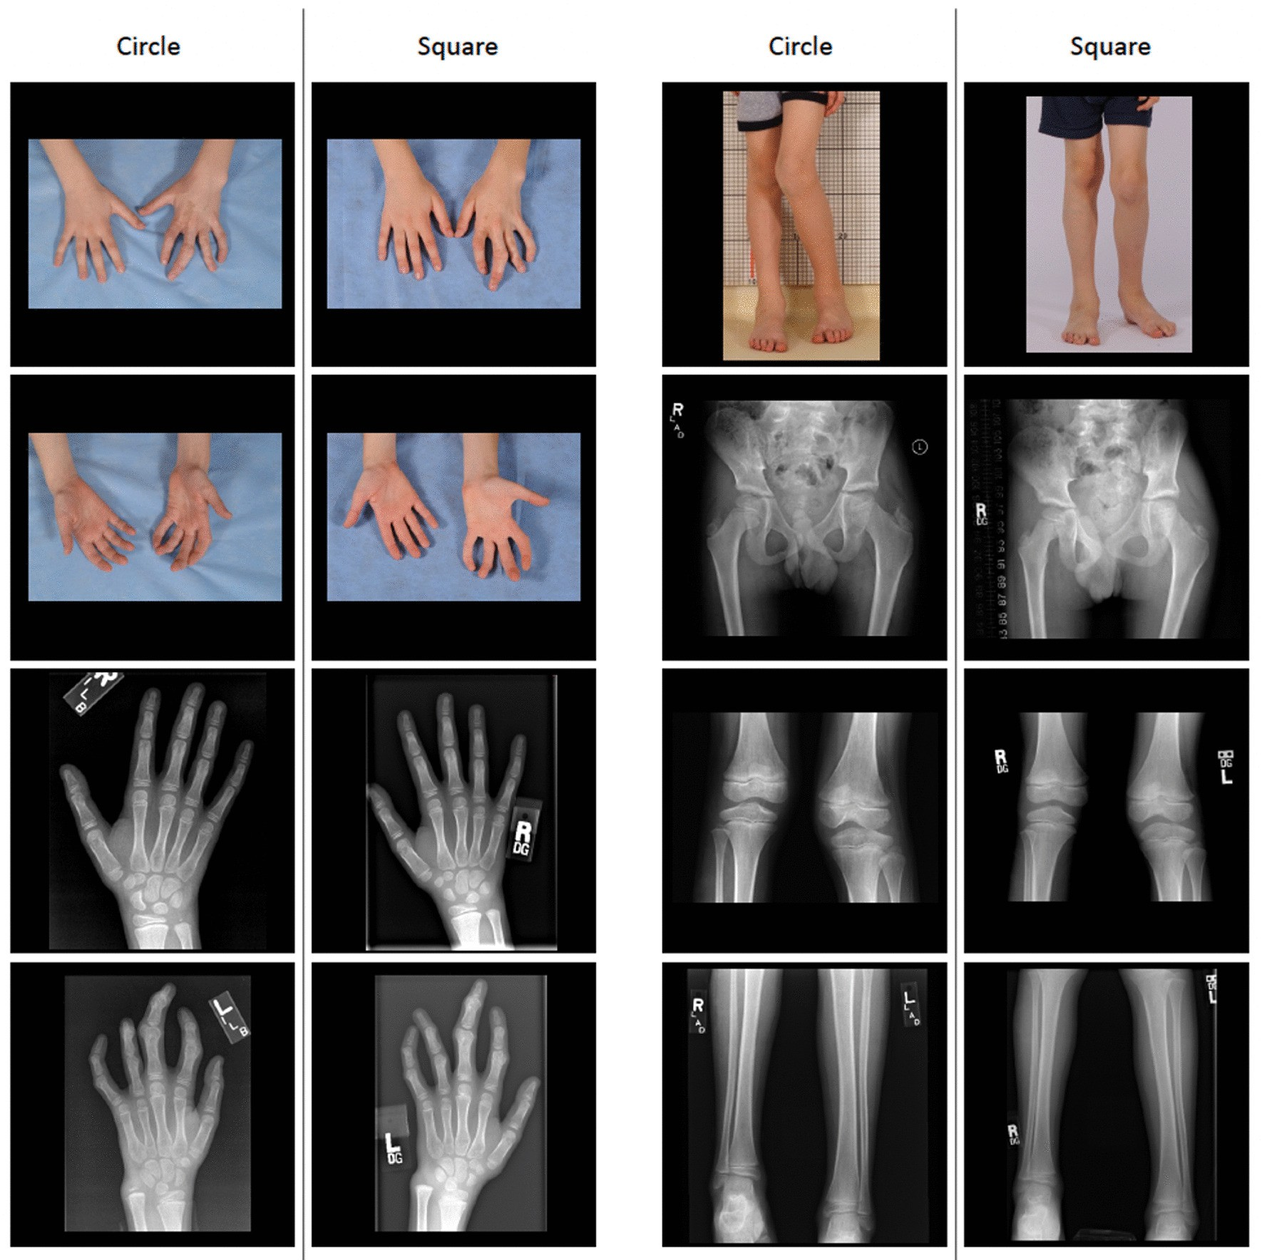
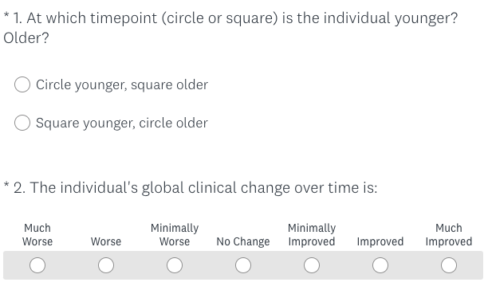
Clinical Gestalt Assessment:
a visual clinical global impression scale for Proteus syndrome
Ours et al., Orphanet, 2022.

Slide 22
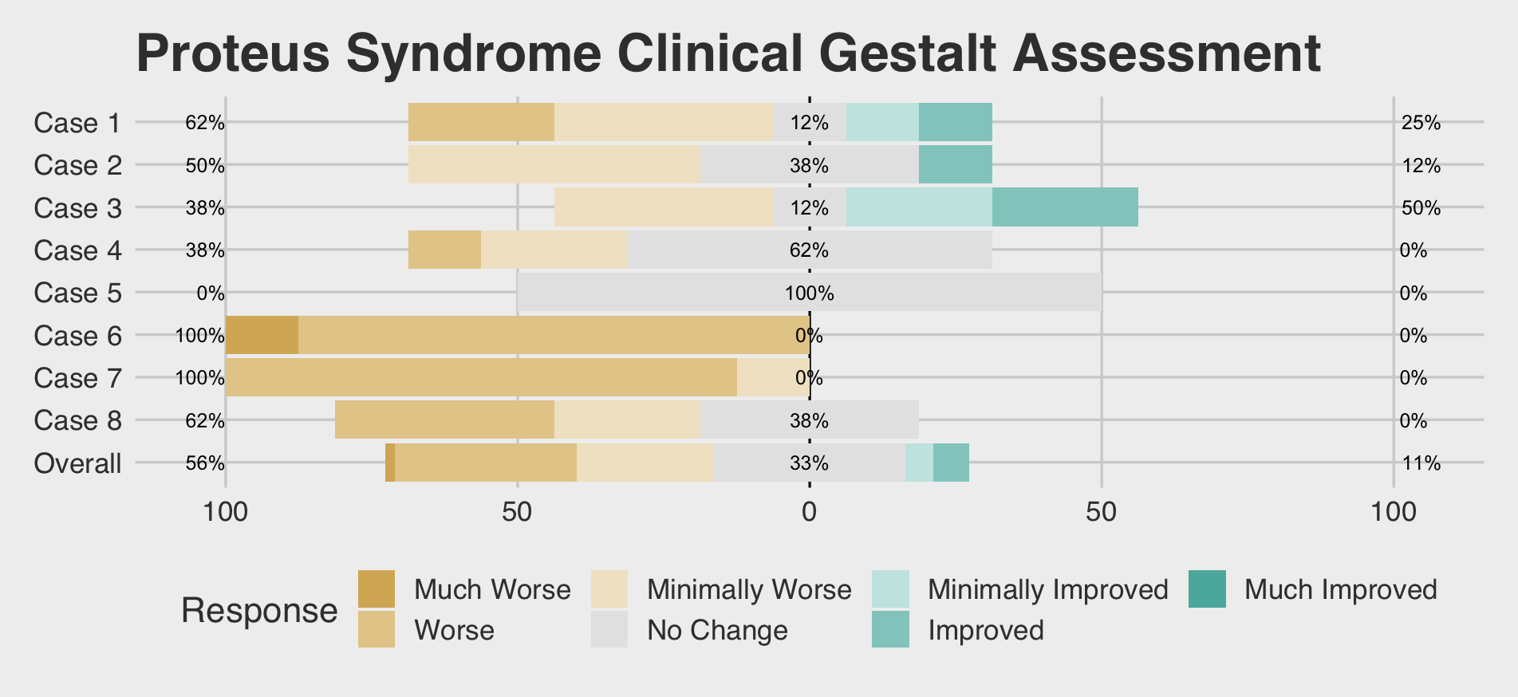
k=8 raters
ICC (2,1) of 0.46 (95% CI 0.24-0.75)
ICC (2,k) of 0.87 (95% CI 0.72-0.96)
Estimate of 3.3 (95% CI 2.5-4.0) corresponding to Minimally Worse
Ours et al., Orphanet, 2022.

Slide 23
Does it work?

Slide 24
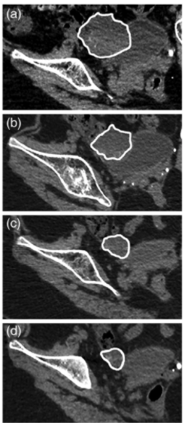
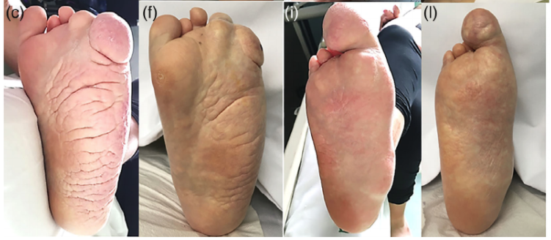
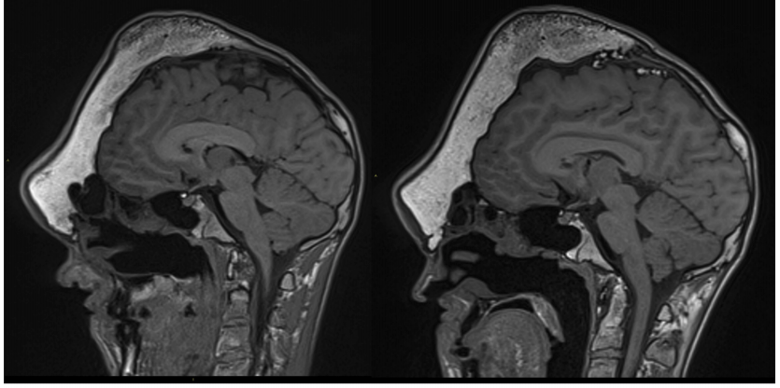
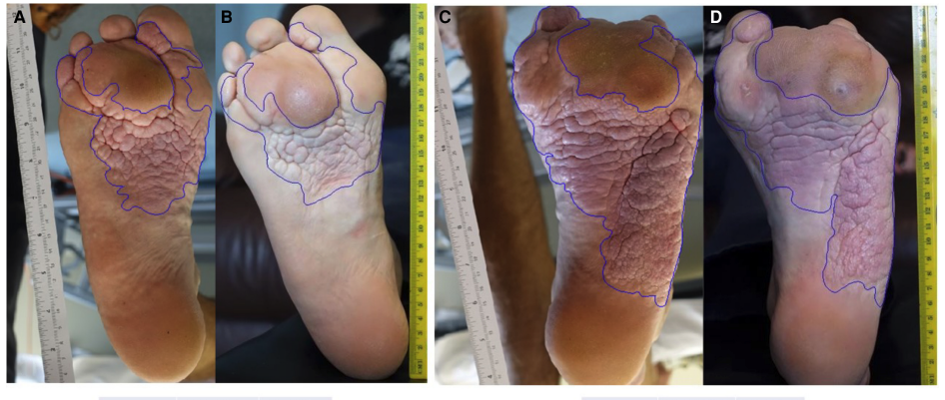
First signs…
Leoni et al., AJMG, 2019.
Biesecker et al., Cold Spring Harb Mol Case Stud, 2020.
Notes:
CT scans of pelvis showing decrease in xyz of LGSOC
at baseline (A, RECIST 1.1: diameter 52 mm, volume 137.6 mL), at
6-month (B, RECIST 1.1: diameter 39.2 mm, volume 54.6 mL), at
12-month (C, RECIST 1.1: diameter 28.1 mm, volume 16.7 mL), at
19-month (D, RECIST 1.1: diameter 20.1 mm, volume 6.6 mL
FIGURE 3 Photographs at baseline and after 22 months of treatment: left hand and foot (panels A, B, C at baseline and D, E, F after
22 months of treatment), right hand and foot (panels G, H, I at baseline and L, M, N after 22 months of treatment
Areas of cerebriform lesion on soles before (A,C) and at follow-up after 12 mo treatment with miransertib 50 mg (25 mg/m2 ) per day (B,D), for right (A,B) and left (C,D) sole. Underneath the photographs are calculated areas of the lesion on each sole (see Methods).
Representative MRI photographs from before treatment and after 11 mo treatment. (A) Sagittal brain T1 MRI from baseline (left) and after 11 mo (right) showing no obvious progression of skull deformity or new lesion.

Slide 25
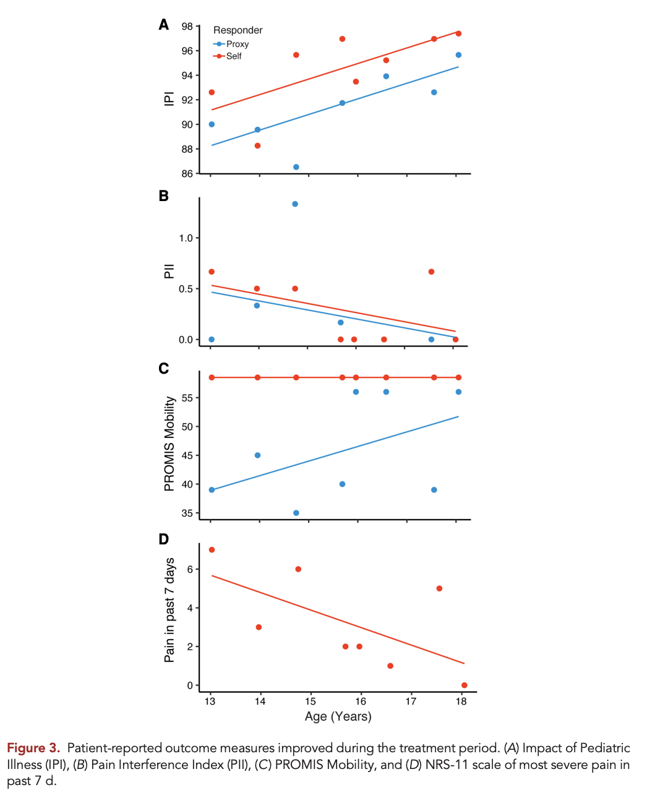
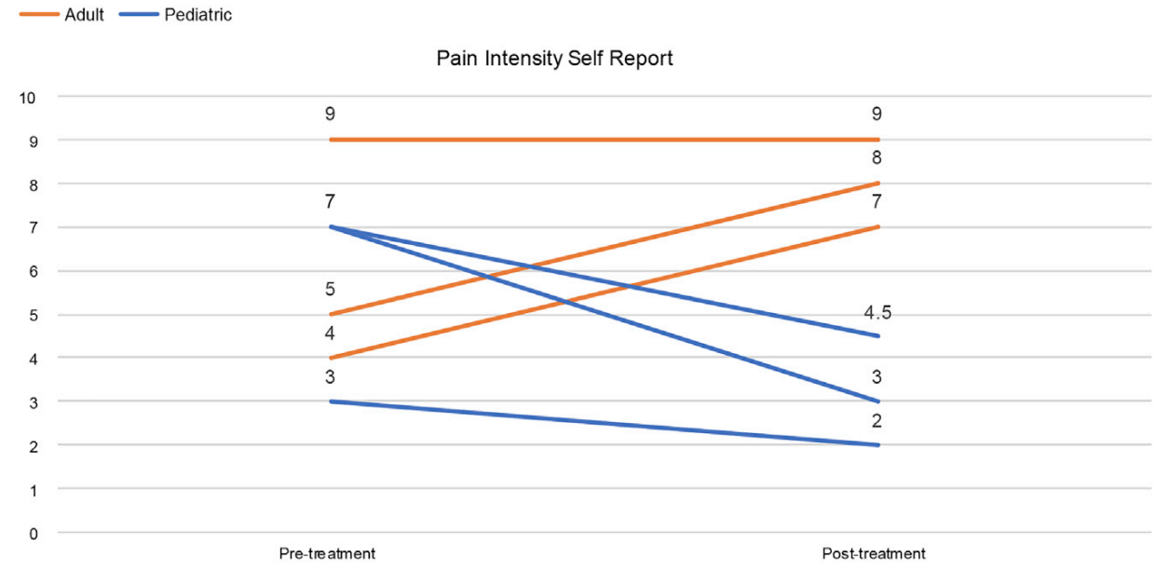
First signs…
Keppler-Noreuil et al., AJHG, 2019.
Ours et al., CSHMCS, 2021.

Slide 28
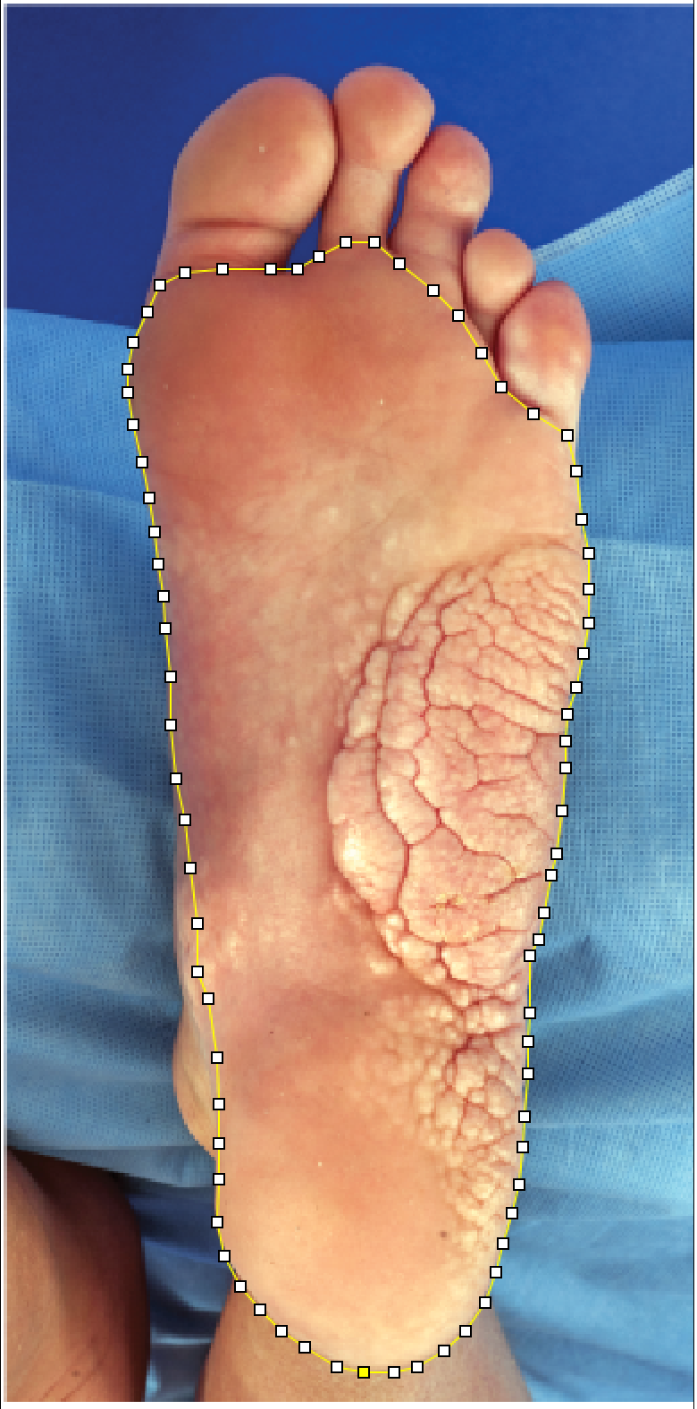
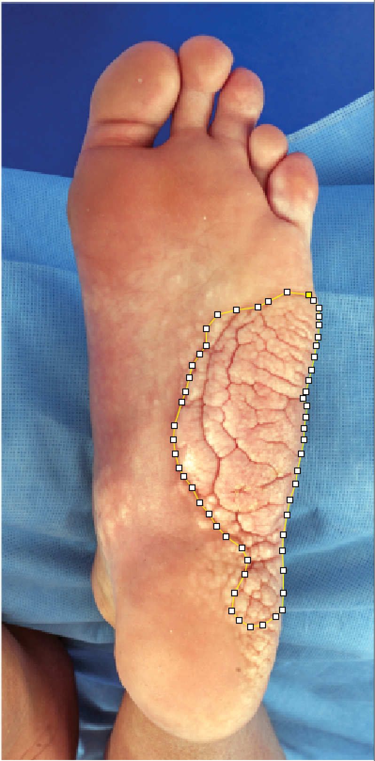

Slide 29
Does it really work? “Phase 2”

Slide 30
AIM Proteus
AKT Inhibitor Miransertib in Proteus Syndrome

Slide 31
Big picture…
Everyone on the study receives miransertib for 4 years
Frequent monitoring by doctor visits at NIH and blood work for safety, especially in the first year
Every 6 months are many tests and surveys to track Proteus syndrome
blood work, imaging (Xray/CT/MRI/photography), breathing and walking tests, questionnaires, and others.

Slide 32
How is this study seeing if miransertib works?
Photos of CCTN to see if it continues to grow
Questionnaires about Proteus syndrome affects life and function
Compare images from start of treatment to those on treatment overtime
Compare labs like D-dimer to see if this improves on treatment

Slide 33
Eligibility – Who can participate?
Cohort 1
3-16 years old
CCTN on the bottom of the foot
Cohort 2
>3 years old
Cohort 3
>3 years old
Have taken miransertib before

Slide 34
Dosing
Daily pill
If you cannot swallow pills, there may be other ways to take miransertib
“Cycles” = 28 days (4 weeks)
Cycle dosing
First 3 cycles = 15 mg/m²
Cycle 4 until end = 25 mg/m²

Slide 35
Trial Timeline
Trial begins enrollment
Expected to end enrollment
End of trial
June 2022
June 2024
June 2026
June 2028
Example participant timeline

Slide 36
How many visits are we talking about?
Total study length: 4 years
Cycle 1-14 (year 1) → 9 visits
Cycle 15-27 (year 2 ) → 4 visits
Cycle 28-40 (year 3) → 4 visits
Cycle 41-52 (year 4) → 4 visits

Slide 37
How long is each visit?
First visit will be 1-2 weeks
Most follow up visits are just one day
Every 6 months there will be a 3-5 day visit

Slide 38
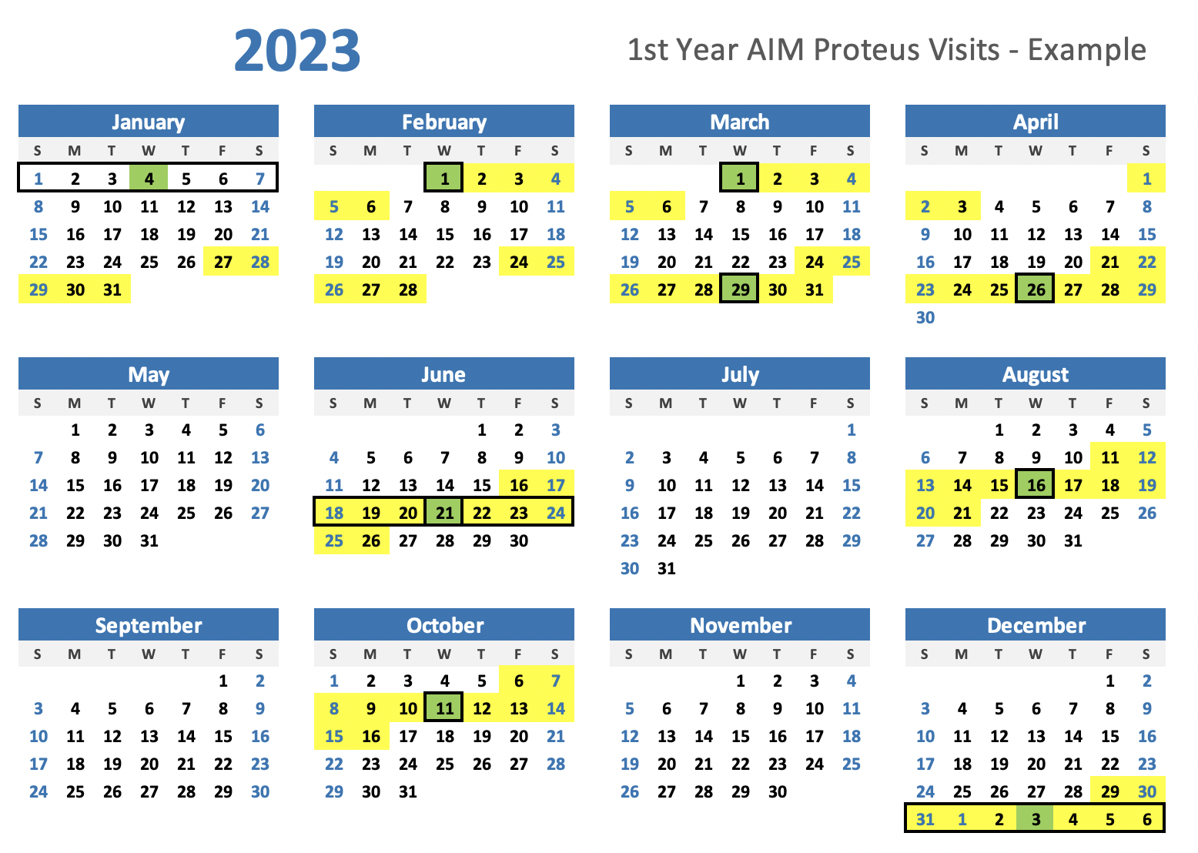

Slide 39
Which tests will you do?
Long visits
(3-5 days every 6 months)
Doctor Visit
Tests
Blood test
Urine test
Lung test
Imaging
X-ray
Low Dose CT
Ultrasounds
MRI
Photography
Misc.
Surveys
Consultations
Short visits
(~1 day every 4 weeks)
Doctor Visit
Blood & urine tests
Tests are not exactly the same for each person

Slide 40
What’s next…
Contact us if you are interested in participating or have any questions.
If you don’t think this clinical trial is for you but would like to support our natural history study, please, also let us know.
We are scheduling visits!
301-443-3962
proteustrial@nih.gov

Slide 41
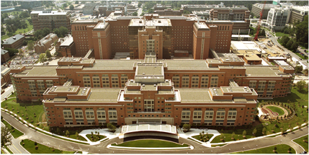
Acknowledgements
Leslie Biesecker
Julie Sapp
Lenita Smith
Emily Modlin
Olivia Rostagni
Marjorie Lindhurst
Jennifer Johnston
Laura Tosi
Thomas Darling
Patients and Families
Proteus Syndrome Foundation
NIHCC
Merck

