Slide 1
A Brief History of Proteus Syndrome Research Progress
Leslie Biesecker, MD
PSF Joint Family Conference
2022

Slide 2
Where this all started…
Not clear who had Proteus
  No diagnostic criteria
Did not understand range of severity
Did not have clear prognosis
Little information on practical management
Did not know cause
No specific treatment

Slide 3
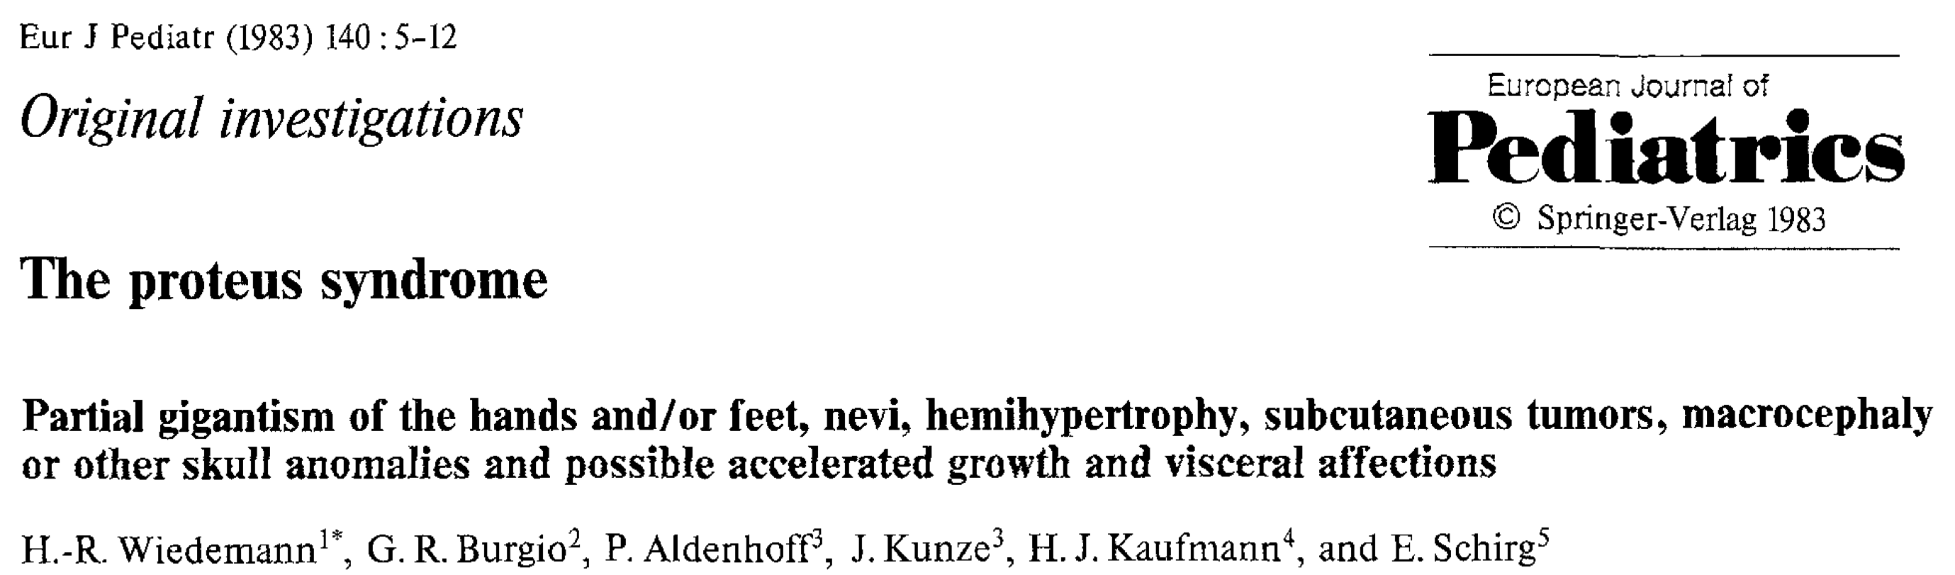
39 Years Ago – 1983
Modern description of Proteus
Prof. Wiedemann
Four patients
1983
1980’s
1990’s
2000’s
2010’s
2020’s

Slide 4
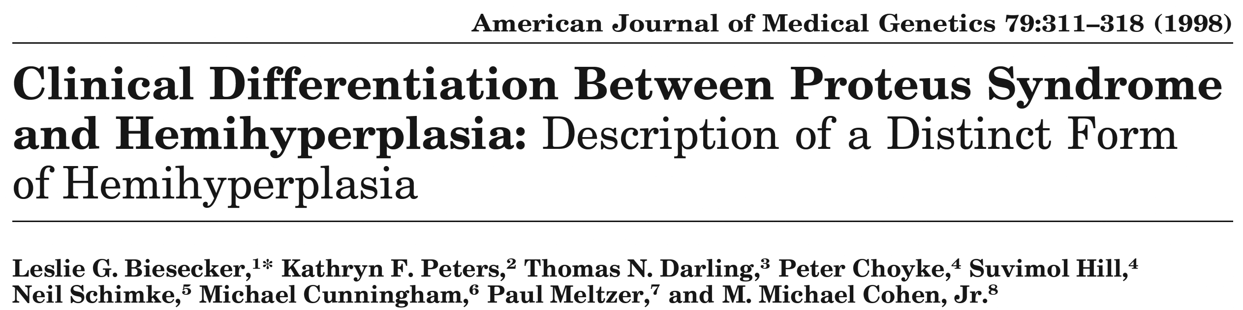
26 Years Ago – 1998
Launch of NIH research program
Proteus NIH Clinic
18 patients
Began diagnostic splitting – Non-proteus mosaic overgrowth
1983
1998
1980’s
1990’s
2000’s
2010’s
2020’s

Slide 5
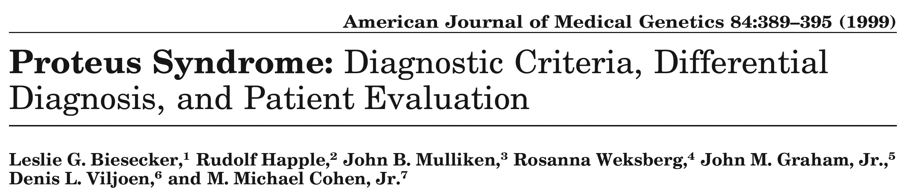
23 Years Ago – 1999
Specific diagnostic criteria
Controversial
Difficult to ‘undiagnose’ individuals
1999
1983
1998
1980’s
1990’s
2000’s
2010’s
2020’s

Slide 6
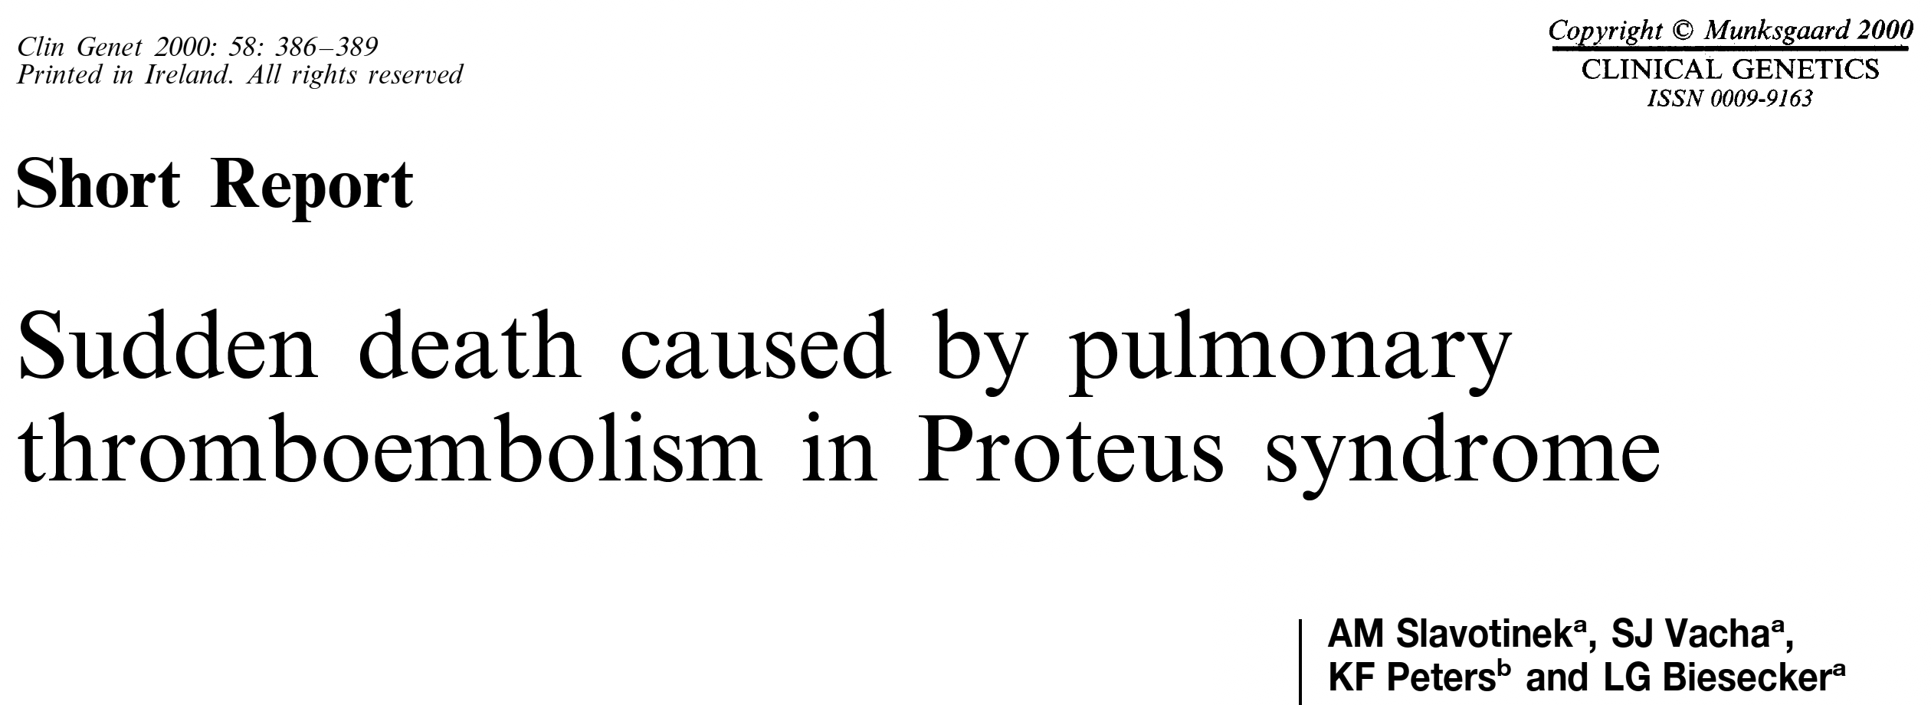
22 Years Ago – 2000
Recognition of blood clots and embolism as serious complication
Enabled preventive anticoagulation for surgery and serious illness
1999
1983
1998
2000
1980’s
1990’s
2000’s
2010’s
2020’s

Slide 7
11 Years Ago - 2011
Cause discovered
Somatic mutation in AKT1
Sequencing funded by PSF
1999
1983
1998
2000
2011
1980’s
1990’s
2000’s
2010’s
2020’s

Slide 8
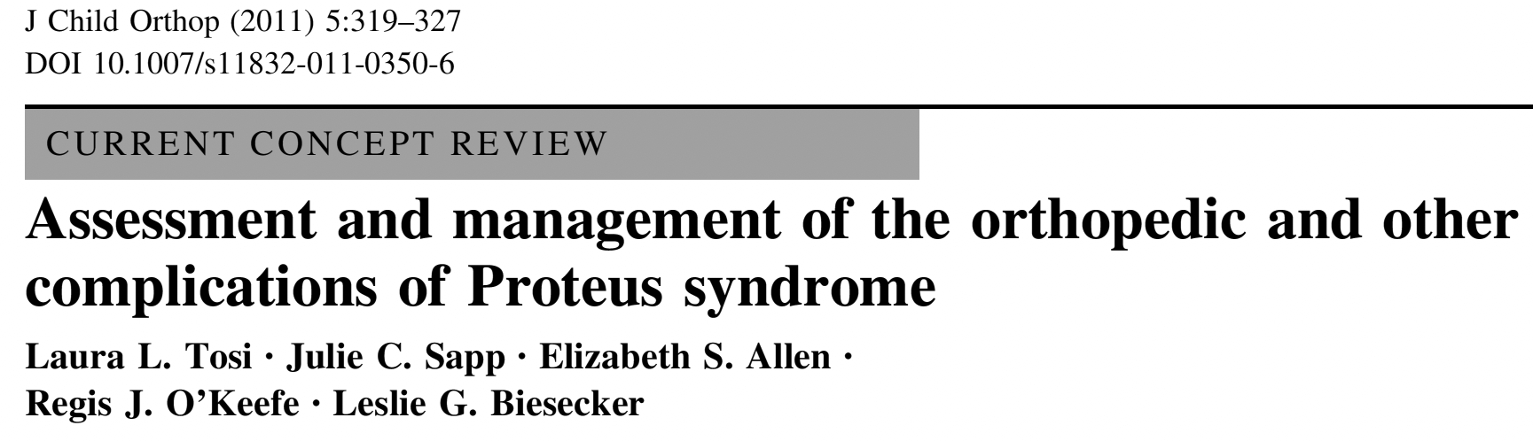
11 Years Ago – 2011
Practical orthopedic management
Avoid problematic surgeries
1999
1983
1998
2000
2011
1980’s
1990’s
2000’s
2010’s
2020’s

Slide 9
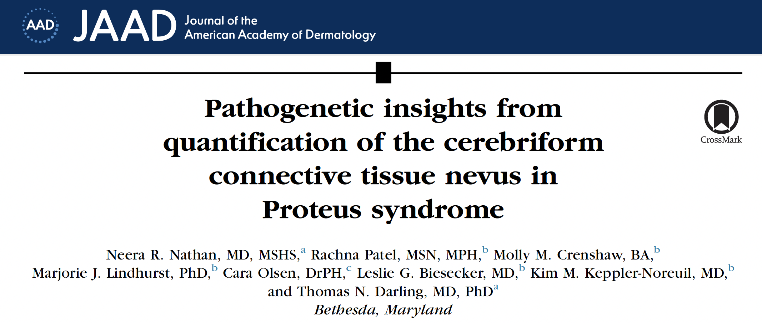
5 Years Ago – 2018
Ability to measure CCTN
Insight into disease
Key for trial outcome measures
1999
1983
1998
2000
2011
2018
1980’s
1990’s
2000’s
2010’s
2020’s

Slide 10
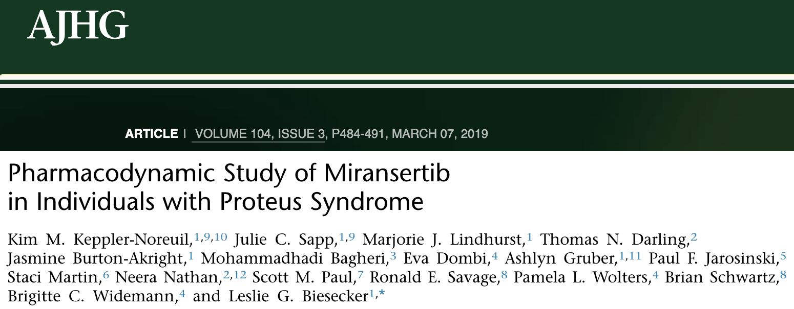
3 Years Ago - 2019
ArQule collaboration
First trial of targeted, specific therapy
Good safety profile
Hints of efficacy
1999
2019
1983
1998
2000
2011
2018
1980’s
1990’s
2000’s
2010’s
2020’s

Slide 11
This Year
Merck collaboration
Efficacy trial
We have come a long way, together
1999
2019
1983
1998
2000
2011
2018
1980’s
1990’s
2000’s
2010’s
2020’s

Slide 12
The Future
Future trials
  Refine, optimize treatment
  New medications
Earlier diagnosis
Gene correction

Slide 13
The Future
Future trials
  Refine, optimize treatment
  New medications
Earlier diagnosis
Gene correction
Thanks to
PSF US & UK
Study participants
NIH
Chris Ours, Julie Sapp, Lenita Smith, Olivia Rostagni, Laura Tosi, Tom Darling, and many others

