Slide 1
AIM Proteus: the mouse edition
Marjorie Lindhurst, PhD
National Human Genome Research Institute
October 7, 2022
Notes:
animal models are important tools for studying human disease because we can use them to investigate things that we can’t address with our human samples or in our patients

Slide 2
Why do we need a mouse model?
ultra rare disorder
limited access to tissue
treatment strategies
identify variant-positive cells & control expression
Notes:
ultra rare, can affect anything, but many tissues are hard to obtain in humans
assess treatment strategies – talk about today
also – to study the biology of PS – have a way to identify variant-positive cells and control their expression to investigate questions that come from results illustrated here
some of you are familiar with this figure – dots represent the variant level in different tissues collected from persons enrolled in our study.
black, red and blue….. increasing level of the variant in the tissue sample as you go left to right
can see a trend where the black dots tend to be farther right, but there are red dots with the mutation and black dots with no level detected. Why?

Slide 3
Mosaic Proteus mouse
Notes:
review the Proteus mouse model

Slide 4
Random expression methodology
Mosaic
Chimera
activator
conditional
Notes:
Mosaic – engineered the mutation into ES cells – but the mutation was “conditional” - means that it wasn’t active
implanted those stem cells in a very early mouse embryo so became part of the embryo
got a “conditional” mouse – had the mutation in all of its cells but it was off
to turn it on we mated the conditional mouse to a mouse that carries the activator Cre gene
lots of different activators - this one is special – expressed in all cells but doesn’t become functional except when the cell is exposed to a drug called tamoxifen

Slide 5
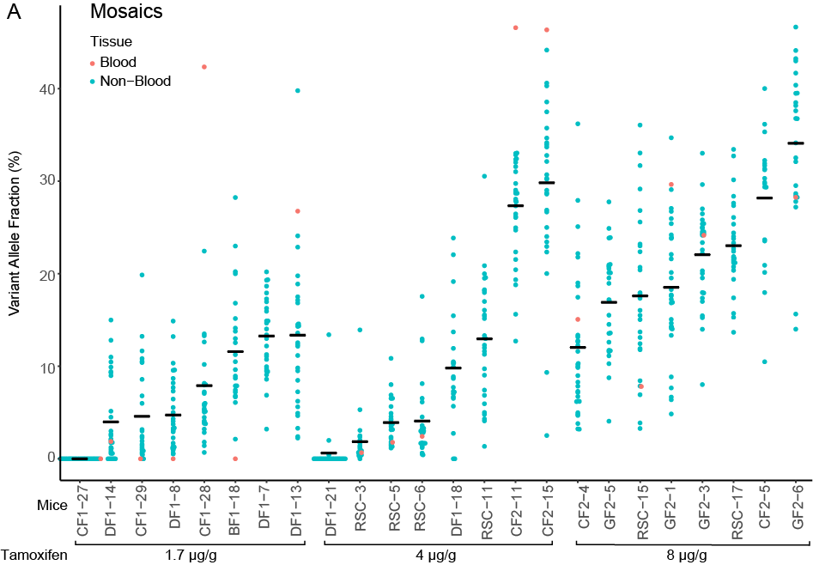
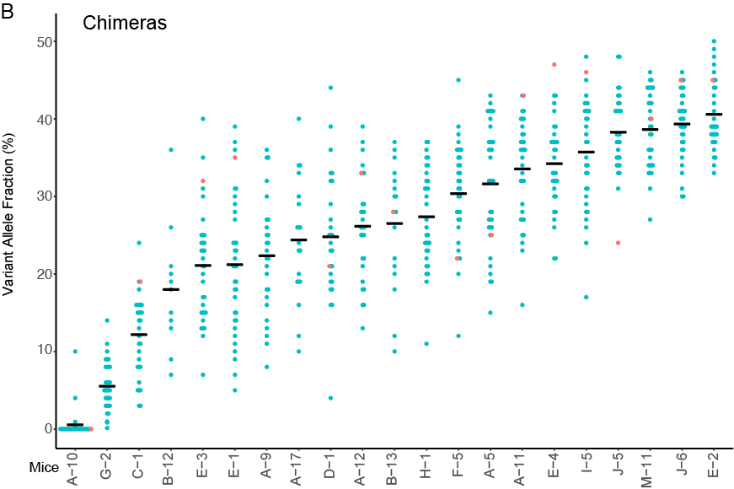
Mouse variant levels
Mosaic
Chimera
Variant allele fraction (%)
Mice
Tamoxifen
Notes:
variant level results from all the tissue we collected
busy slide
each column is a mouse
each dot is a tissue (about 30 tissues/animal)
higher the dot - the more variant in that tissue
left mosaic - organized by amount of drug given to mom
right chimeric
notice - quite a few mouse had variant in every tissue tested
can't tell from the graph - but there wasn't a pattern in the tissue - the same tissue wasn't always the highest one in every mouse - it was random

Slide 6
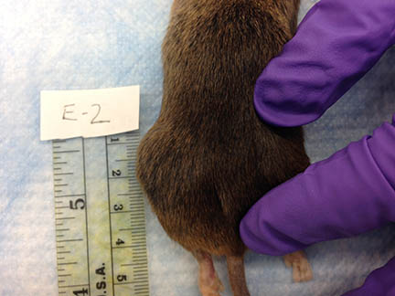
Mouse phenotype
Notes:
They were cute
Some of the mice did not have any observable abnormalities before we needed to sacrifice them.
had to wait a while - only 2 mice developed visible OG before one year; time frame is about same for mice and humans - but mice only live 1-2 years, so mice develop PS when they middle aged instead of when they are children.
But others did – mouse on the right developed a lump on it’s left flank.

Slide 7
Mouse overgrowth – vascular malformations
mouse
human
1000
2000
Notes:
what was that lump on the side of the mouse? - a vascular malformation. When we examined it we saw that it looked very much like VMs seen in humans – comprised of venous, capillary or mixed venous/capillary vessels that were greatly enlarged

Slide 8
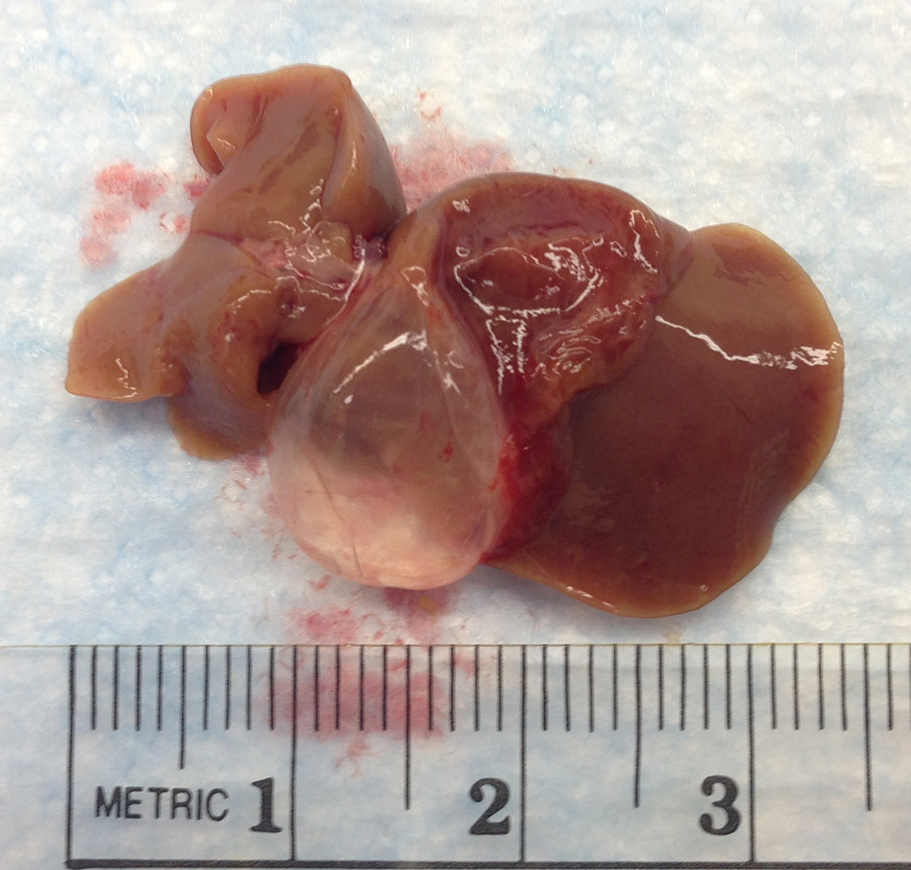
Mouse overgrowth – cysts
100
Notes:
we also saw cysts – which are also seen in human disease. left is a liver cyst, right is a spinal cord cyst

Slide 9
Mouse overgrowth - hyperplasia
mouse
human
200
200
Notes:
also saw hyperplasia - too many cells. left is an example of epidermal hyperplasia on the ear. bottom is the normal width of the epidermis; similar to the epidermal nevi seen in patients with PS

Slide 10
Proteus syndrome mouse phenotype
Types of lesions
10
10
Vascular malformations
Cysts & ectasia
69
28
Hyperplasia & stromal OG
Mammary OG

Slide 11
Proteus syndrome mice
Mosaic & chimeric methods were successful
Manifested overgrowth seen in human Proteus syndrome
Observable lesions rare before one year of age in mice
Akt1^{E17K}-positive cells in a variety of affected and unaffected tissues
Notes:
simplify

Slide 12
Ubiquitous Proteus mouse

Slide 13
Happle hypothesis
Rudolf Happle:
“The action of a dominant lethal gene surviving by mosaicism would explain the marked variability of the signs and symptoms which gave reason to name the syndrome after the Greek god Proteus.”
Can we use the mouse model to test this hypothesis?
Human Genet (1986) 72:280

Slide 14
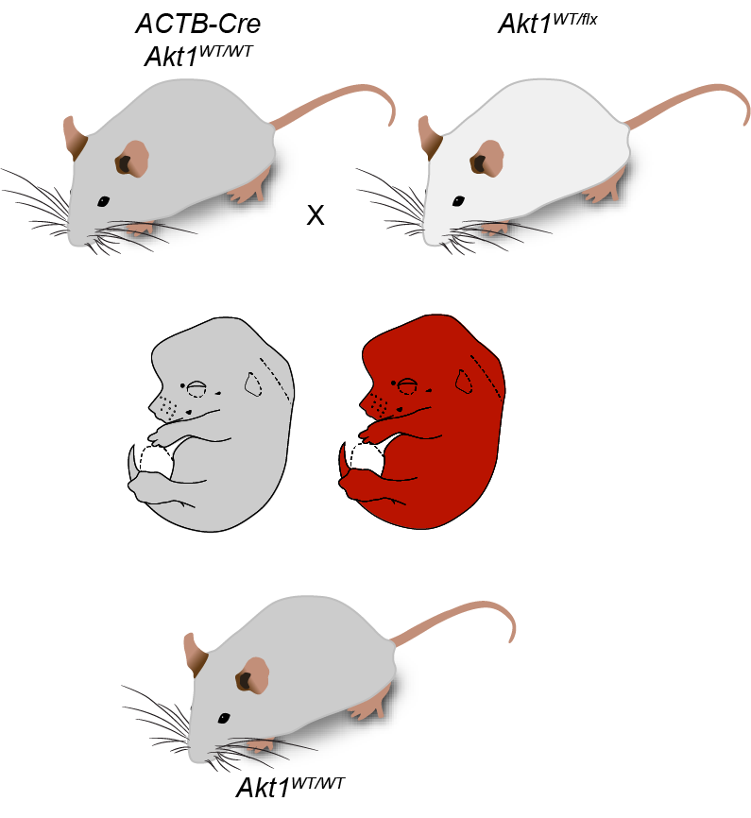
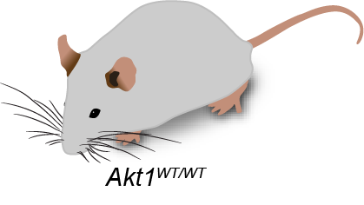
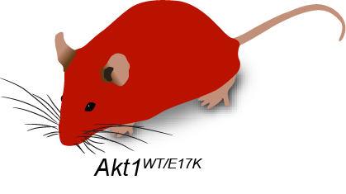
Ubiquitous expression of Akt1^{E17K}
ACTB-Cre
Akt1^{WT/WT}
Akt1^{WT/flx}
activator
conditional
βA-Akt1^{WT/WT}
activator
conditional
βA-Akt1^{WT/flx}
βA-Akt1^{WT/WT}
βA-Akt1^{WT/flx}
n = 99
n = 0

Slide 15
Gross phenotype

Slide 16
Vascular remodeling defect - skin
PECAM-1

Slide 17
Tissue specific expression of Akt1^{E17K}
activator
 | Number of pups
 | Cre^{NEG} | Cre^{POS} | Cre^{NEG} | Cre^{POS}
Cre | Akt1^{WT/WT} | Akt1^{WT/WT} | Akt1^{WT/flx} | Akt1^{WT/flx} | P value
Tie2 | 75 | 52 | 76 | 44 | 0.0052
Sm22α | 20 | 19 | 25 | 14 | 0.3723
Nkx2.5 | NA | 59 | NA | 42 | 0.0907
Tie2-Cre
endothelium
activator
Sm22α-Cre
smooth muscle
activator
Nkx2.5-Cre
heart

Slide 18
Whole embryo staining
E12.5
E12.5
α-SMA
PECAM-1
WT/WT
WT/E17K

Slide 19
Abnormal development – vertebral arteries
E12.5
E12.5
α-SMA
PECAM-1
WT/WT
WT/E17K
Notes:
zoom in - spikes in mutant not in WT
VTA - connects DA to basilar - never forms properly in mutant
interestingly, it does start to form but tips don't connect
varies from mutant to mutant as to how far it goes
mutants try to bypass the break, green arrows
this varies too - some are more successful

Slide 20
Vascular remodeling defect – aortic arch
E12.5
E12.5
α-SMA
PECAM-1
WT/WT
WT/E17K
Notes:
remodeling problem in large vessels too
several things need to happen for remodeling both large and small vessels
regression of an area
srpouting of new vessel
migration or connection of EC cells to get vessels in correct place and to connect up tubes like in VTA

Slide 21
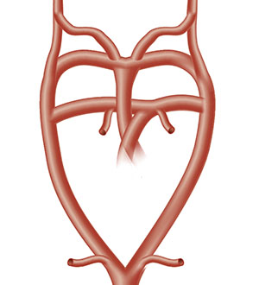
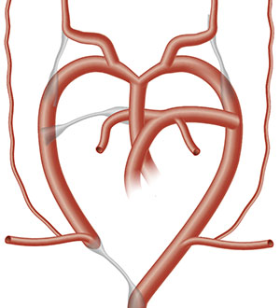
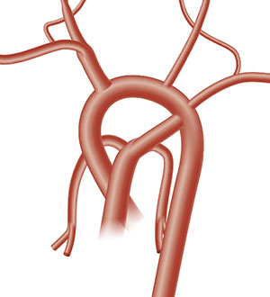
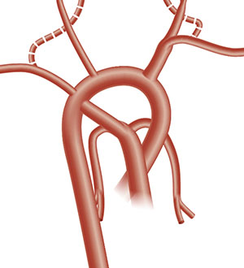
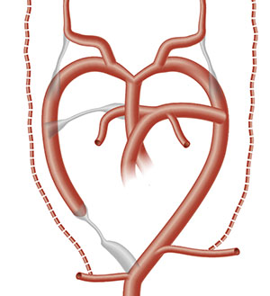
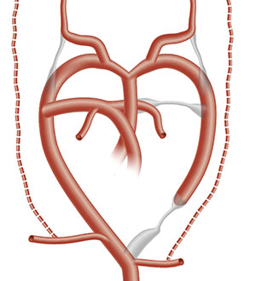
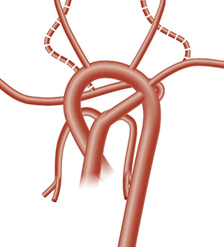
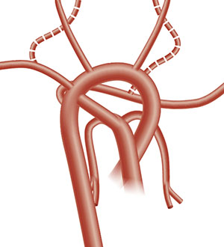
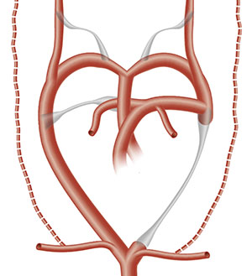
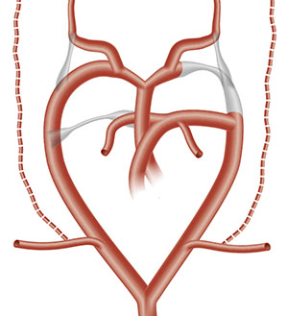
Types of aortic arch structures in βA-Akt1^{WT/flx} embryos
Age | Normal |  |  | Abnormal
 |  |  |  | Type 1 | Type 2 |  |  |  | Type 3
 | Early | Intermediate | Late |  | Intermediate |  | Late |  | A | B
 |  | left arch | left arch | right arch | left arch | right arch | left arch | right arch
E11.5 | 2 |  |  |  | 1 | 4 |  |  | 3
E12.5 |  | 6 |  | 1 |  | 3 |  |  | 2 | 2
E13.5 |  |  | 2 | 2 |  |  |  | 3 |  | 1
E14.5 |  |  | 5 | 3 |  |  | 1 | 2

Slide 22
Ubiquitous Akt1^{E17K} mice
Ubiquitous Akt1^{E17K} expression is lethal
Results in defective vascular development and remodeling
Restricted expression of Akt1^{E17K} in vascular components is not lethal
Hypothesis: malformations are due to constitutive AKT signaling in multiple cell types
Notes:
multiple cell types that together result in remodeling defects

Slide 23
AIM Proteus: the mouse edition
Notes:
that’s a bit of what we’ve learned about the functional consequences of E17K
talk about how we can use the model for treatment testing

Slide 24
Which model to use?
OR
Pros: “true” Proteus
Cons: variable phenotype
long duration
outcome measures challenging
Pros: consistent manifestations
short duration
outcome measures straightforward
Cons: drug must cross placenta

Slide 25
Mouse treatment trial design
ACTB-Cre
Akt1^{WT/WT}
βA-Akt1^{WT/WT}
activator
βA-Akt1^{WT/WT}
X
Akt1^{WT/flx}
?
conditional
βA-Akt1^{WT/flx}
drug
βA-Akt1^{WT/flx}

Slide 26
Primary questions:
Does miransertib cross the placenta?
Does miransertib increase survival time of the embryos?
i.e. Are there any βA-Akt1^{WT/flx} pups?

Slide 27
Embryonic tissue levels
wild-type
E13.5
X
start on E1.5
daily for 5 days
rest for 2 days
repeat
wild-type
miransertib
Notes:
parents were all wild type for AKT, some carried Cre or RosaTomato
mice got 10 doses of drug

Slide 28
Embryonic tissue levels
Embryonic tissue miransertib concentration
miransertib concentration (nM)
Litter
PK11
PK8
PK1
PK2
PK16
PK12
PK13
PK18
PK19
PK15
Dose (mg/kg)
30
45
60
60
68
75
75
83
83
90
Maternal plasma miransertib concentration (nM)
71
36
18
14
120
64
89
310
162
1400
Notes:
10/11 litters had embryos with detectable levels of miransertib; tested 5 embryos per litter
(remember this is log scale)
intra-litter variability is low
inter-litter variability is high
maternal plasma paralleled embryonic levels

Slide 29
Primary questions:
Does miransertib cross the placenta?
YES
Does miransertib increase survival time of the embryos?
i.e. Are there any βA-Akt1^{WT/flx} pups?

Slide 30
Efficacy - strategy
ACTB-Cre
Akt1^{WT/WT}
βA-Akt1^{WT/WT}
activator
βA-Akt1^{WT/WT}
X
Akt1^{WT/flx}
start on E0.5 – E2.5
daily for 5 days
rest for 2 days
repeat cycle until birth
?
conditional
βA-Akt1^{WT/flx}
miransertib
βA-Akt1^{WT/flx}
Notes:
gestation is 19-21 days typically, so this would mean that the females should get 15 doses of drug
monitor females when they get close to delivery date
collect tails and fix any pups that are found dead or died neonatally
genotype tails as usual of any survivors

Slide 31
Efficacy - results
Offspring from ACTB-Cre and AKT1^{WT/flx} matings at P28
Alive
Dead
Numbers of pups
WT
MUT
WT
MUT
WT
MUT
untreated
60 mg/kg
90 mg/kg
Notes:
Summary data of the 5 efficacy rounds done so far:
number of pups (with genotypes) that survived to birth
alive = whether they were alive at P28 (so all Lucky’s and the WT that did post weaning are counted in this graph)
P28 – basically the number of pups that survived until weaning
details in a minute

Slide 32
Efficacy - results
Current Survival
Notes:
left graph
all the data – no untreated pups have died yet – all WT (no mutant pups born to untreated moms)
Oldest untreated – 275 days
oldest WT 60 – 169 days
oldest mut 60 – 166 days
oldest WT 90 – 119 days
oldest mut 90 – 117 days
right graph –
survival at P30
show the earlier part of the curve
if found dead at first check = 0.05 days
litters checked for the most part around 6:30-7:00 am and then between noon and 2 pm

Slide 33
Primary questions:
Does miransertib cross the placenta?
YES
Does miransertib increase survival time of the embryos?
i.e. Are there any βA-Akt1^{WT/flx} pups?
YES

Slide 34
What does this mean?
Additional evidence that miransertib may be beneficial in treating the overgrowth from Proteus syndrome
Shows that the ubiquitous model can be used to test drugs that cross the placenta

Slide 35
Acknowledgments
Biesecker lab
Les Biesecker
Megan Detels
Zara Wermers
Nate Laughner
Jasmine Shwetar
Hannah Kondolf
Miranda Yourick
Julie Sapp
Chris Ours
Kim Keppler-Noreuil
NHLBI
Yosuke Mukouyama
Wenling Li
NHGRI animal program
Lisa Garrett
Gene Elliott
Cecilia Rivas
Tannia Clark
NIH Veterinary Resources
Lauren Brinster
NHGRI microscopy core
Stephen Wincovitch
Notes:
That’s it from me for now. I want to thank all these wonderful folks who have worked very hard on the mouse model. This is truly a group effort. And I especially want to thank the Proteus foundation and all of the families for their support ☺

